Slide 1
Industry Performance Analysis for African Countries
Prepared by : Sithandilizwe Malunga, Data Analyst

Slide 2
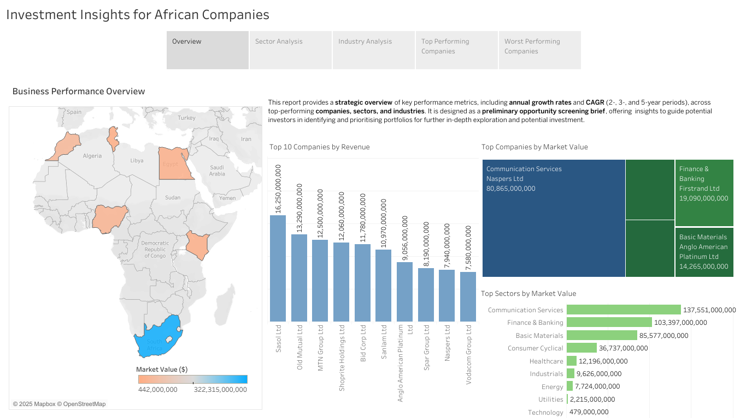

Slide 3
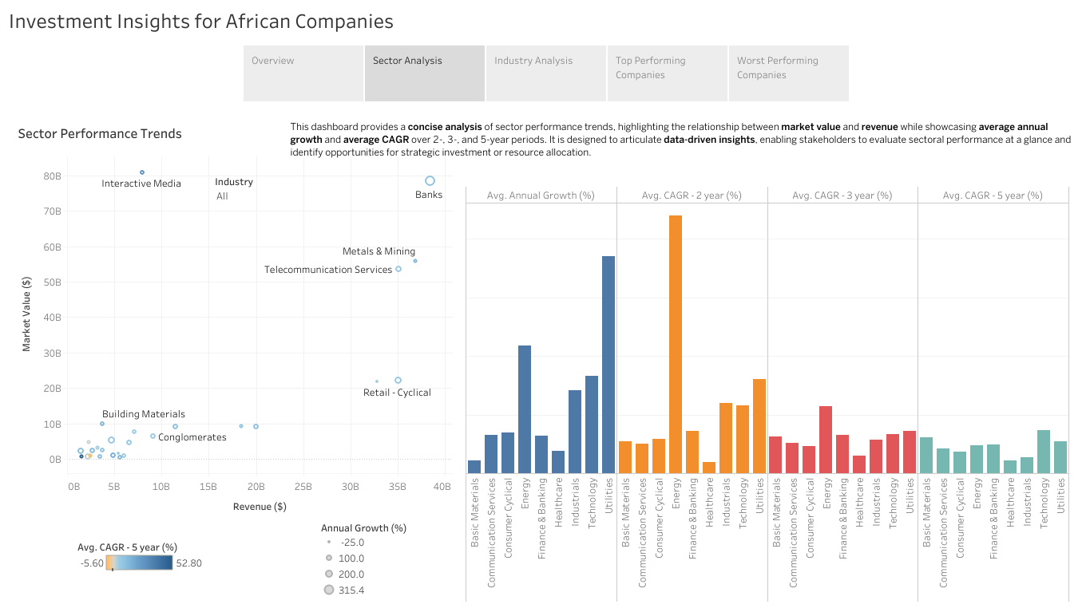

Slide 4
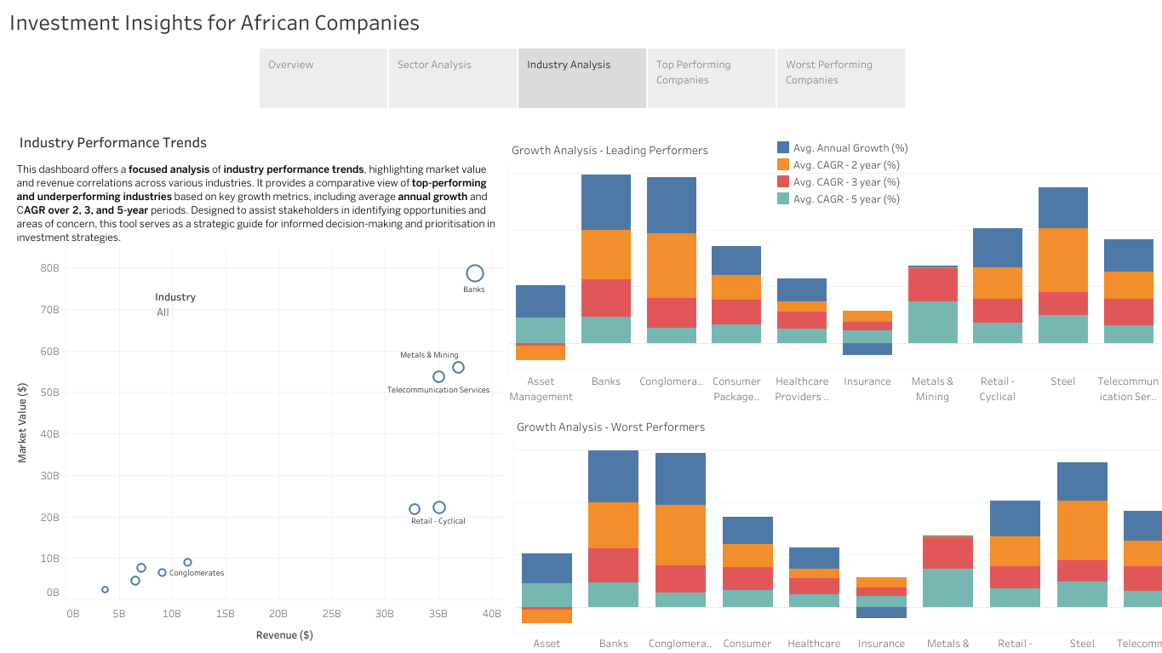

Slide 5
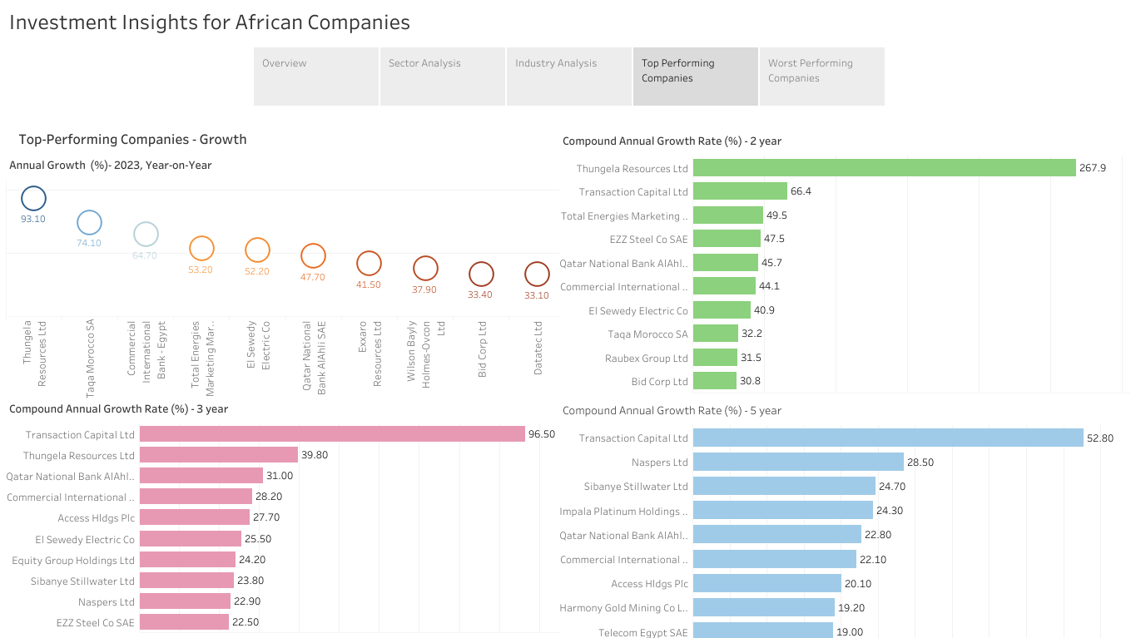

Slide 6
